Slide 1
Amazon Web Services

Slide 2
ToC - Agenda
Introduction to AWS?
AWS Services
        Amazon VPC(Virtual Private Cloud)
        Amazon Route 53
        Amazon Direct Connect
        Amazon EC2(Elastic Compute Cloud)

Slide 3
AWS VPC
Introduction to VPC
Subnets
Route Tables(NCLs)
Security Groups
VPC Modules

Slide 4
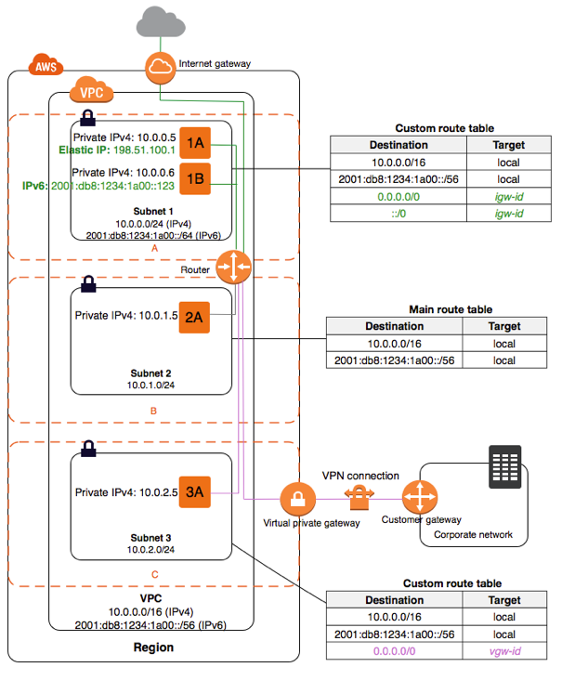
Architecture of VPC

Slide 5
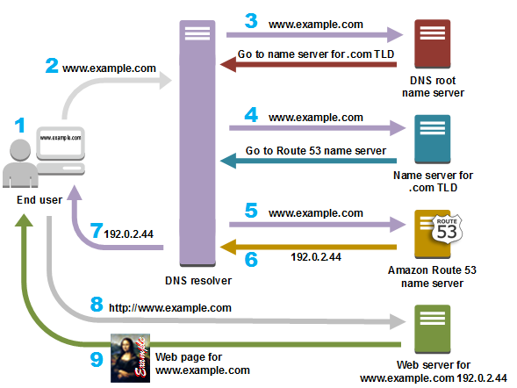
Amazon Route 53
What is Amazon Route 53?
The following diagram shows How R53 route the internet traffic to the resources for your domain

Slide 6
Amazon Route 53
Routing policies of Amazon Route 53
Features of Amazon Route 53
Key Benefits of Amazon Route 53

Slide 7
AWS Direct Connect
What is AWS Direct Connect(DX)?
Why AWS Direct Connect?
How is DX different from a VPN?
Direct Connect Connections
Direct Connection Benefits

Slide 8
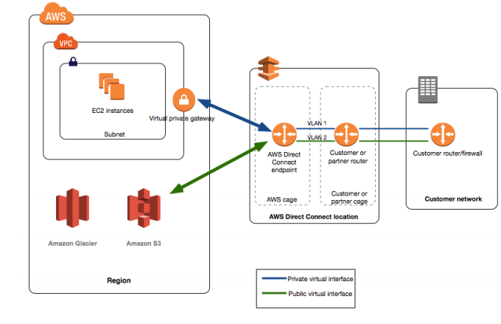
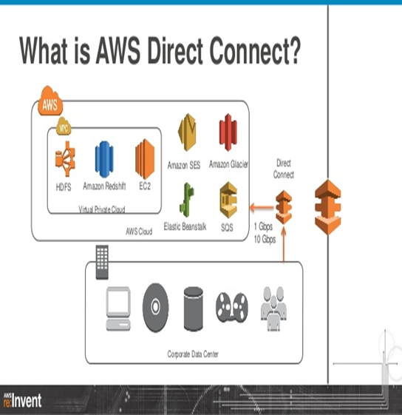
Architecture of Direct Connect
The following diagram shows how AWS Direct Connect interfaces with your network

Slide 9
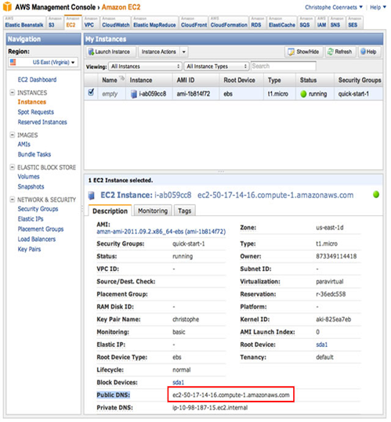
Amazon EC2(Elastic Compute Cloud)
Introduction to Amazon EC2
Amazon EC2 Cost Models
Amazon EC2 Instances

